Slide 1
Tutorial 3 Group C10
10th September 2018
Joanne Ong

Slide 2
Admin
Telegram group at: https://t.me/joinchat/C76a-wpYrPF5Bzhq7O6ysQ
CS1010 tutorial slides at:
https://github.com/joanneong/cs1010
Notes:
You don’t have to join the group, but you can also just join and mute.

Slide 3
Plans for today
Tutorial segment:
Review: Kahoot
Recap: if-else
Problem 8.1
Problem 8.2
Problem 8.3
Problem 9.1
Problem 9.2
Problem 9.3
Lab segment:
Review: Exercise 1
Exercise 2
Notes:
Today, we will be covering problem sets 8 and 9. Then, we will talk about Exercise 1 and exercise 2.

Slide 4
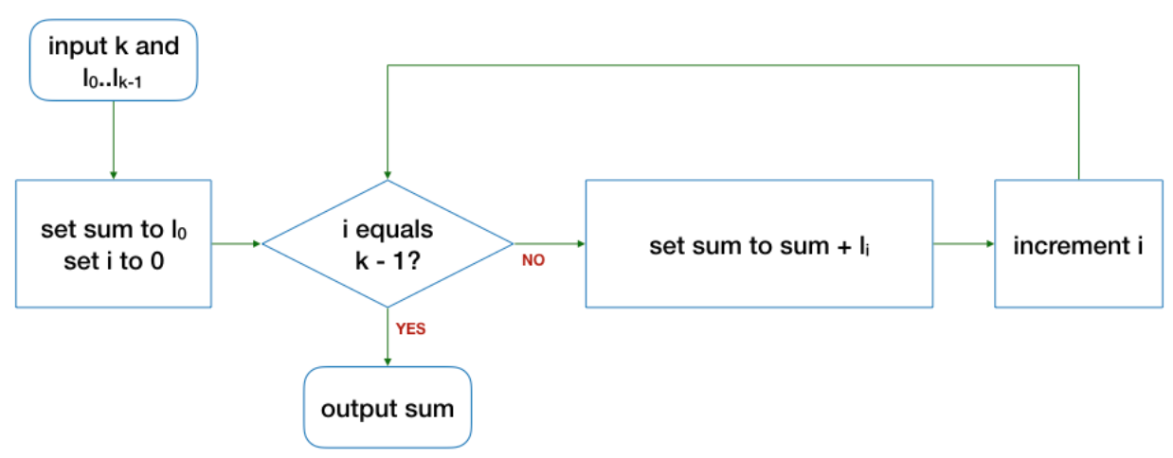
Review: Kahoot
Question 1
What is the output of the algorithm in the flowchart below if the input L is 10, 7, 1?
Notes:
Does anyone know the answer to this question?
The answer is 27. Why?
First element is repeated
Last element is not counted

Slide 5
Review: Kahoot
Question 1
The answer is 27.
- First element is repeated
- Last element is not counted

Slide 6
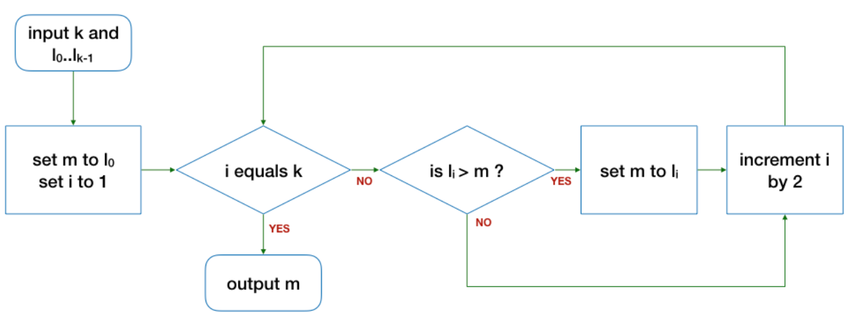
Review: Kahoot
Question 2
What is the output of the algorithm in the flowchart below if the input L is 5, 6, 10?
Notes:
What about this question?
The answer is 6. Why?
The third element is skipped

Slide 7
Review: Kahoot
Question 2
The answer is 6.
- third element is skipped

Slide 8
Review: Kahoot
Question 3
What is the output of the algorithm in the flowchart below if the input L is 1, 2, 3, 4?
Notes:
What if the input L is 1, 2, 3, 4 instead?
The answer is that there will be no output.
- i increases by 2, so i will never be equal to k
- the program will never stop!!

Slide 9
Review: Kahoot
Question 3
The answer is no output.
- i increases by 2, so i will never be equal to k
- the program will never stop!!

Slide 10
Recap: if-else
General syntax:
Notes:
Let’s look at if statements first.
In general, for an if statement, you have the if, followed by a condition. Then, if the condition is satisfied, the block inside the curly braces will be executed.

Slide 11
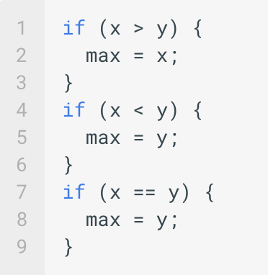
Recap: if-else
Max of two numbers
Notes:
So for example, when we find the max of two numbers, we can consider what are the possible cases.
First, if x is more than y, we want max to be x. If x is less than y, we want max to be y. Then, when x is equal to y, we want max to still be equal to y.

Slide 12
Recap: if-else
Max of two numbers
Can we make this code nicer?
Notes:
So this code works correctly. But how can we improve the code further?
By using else statements!

Slide 13
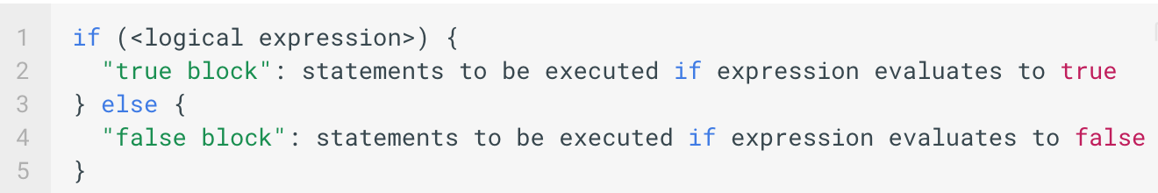
Recap: if-else
General syntax:
Notes:
So with the else statement, the general syntax becomes like this:
An if statement, followed by the code to execute if the expression is true
An else statement, followed by the code to execute if the expression is false

Slide 14
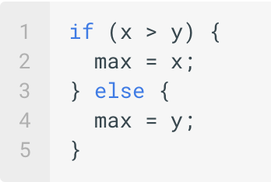
Recap: if-else
Max of two numbers
Notes:
So here, we can replace the last two if statements by a single else statement!
(10 mins by here)

Slide 15
Problem 8.1 (a)
Do the two functions behave in the same way? Explain.
long factorial(long n) { if (n == 0) { return 1; } return n * factorial(n - 1); }
long factorial(long n) { if (n == 0) { return 1; } else { return n * factorial(n - 1); } }
Notes:
(10 mins)
In other words, what this question is asking is whether we always need an else statement to guarantee that the right statement is returned from the function.

Slide 16
Problem 8.1 (a)
Yes, they behave in the same way!
When we reach line 6, we are sure that n is not 0.
long factorial(long n) { if (n == 0) { return 1; } return n * factorial(n - 1); }
long factorial(long n) { if (n == 0) { return 1; } else { return n * factorial(n - 1); } }
Notes:
When we reach this line, we can be sure that n is not equal to 0 for both cases.

Slide 17
Problem 8.1 (b)
Do the two functions behave in the same way? Explain.
long factorial(long n) { long results; if (n == 0) { results = 1; } results = n * factorial(n - 1); return results; }
long factorial(long n) { long results; if (n == 0) { results = 1; } else { results = n * factorial(n - 1); } return results; }
Notes:
Like part (a), this also tests whether the else statement is necessary. So, what do you think?

Slide 18
Problem 8.1 (b)
No, they do not behave in the same way.
long factorial(long n) { long results; if (n == 0) { results = 1; } results = n * factorial(n - 1); return results; }
long factorial(long n) { long results; if (n == 0) { results = 1; } else { results = n * factorial(n - 1); } return results; }
Notes:
This time, they do not behave in the same way.
Consider line 7, which is this line here. For the version on the left, when you reach that line, n can be either 0 or non-zero.
But for the version on the right, when you reach that line, n must not be equal to 0.
Which version do you think is the right one? (The right one… or is it?)

Slide 19
Problem 8.1 (b)
long factorial(long n) { long results; if (n == 0) { results = 1; } results = n * factorial(n - 1); return results; }
Notes:
Why is this algorithm incorrect?
What does it return? For example, consider factorial(1).

Slide 20
Problem 8.1 (b)
long factorial(long n) { long results; if (n == 0) { results = 1; } results = n * factorial(n - 1); return results; }
Never terminates!!
Notes:
The program never terminates! (recursive calls)

Slide 21
?
Problem 8.2
input
x, y
Draw the flowchart for the code snippet:
if (x > y) { max = x; } if (x < y) { max = y; } if (x == y) { max = y; }
Notes:
(5 mins)
Does anyone want to volunteer to draw the code snippets?

Slide 22
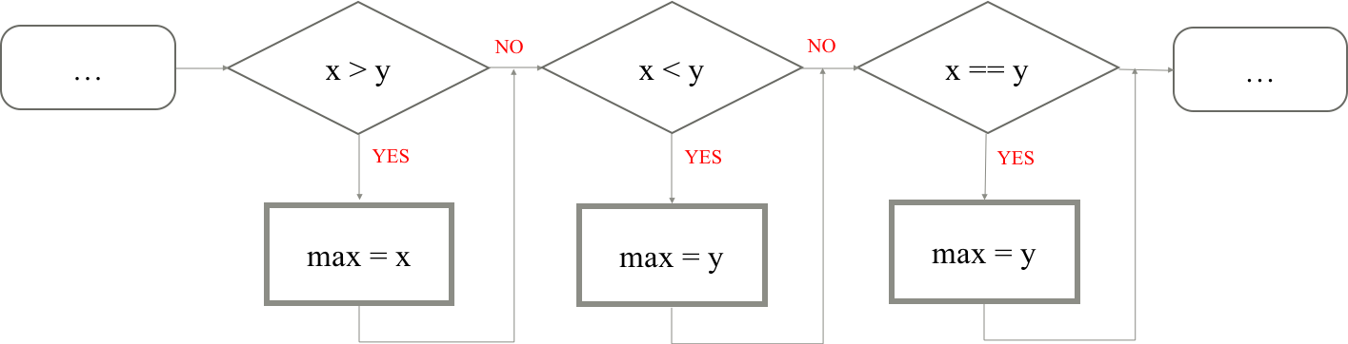
Problem 8.2

Slide 23
?
Problem 8.2
input
x, y
Draw the flowchart for the code snippet:
if (x > y) { max = x; } else { max = y; }

Slide 24
Problem 8.2
x > y
max = y
…
…
NO
YES
max = x

Slide 25
Problem 8.2
if (x > y) { max = x; } if (x < y) { max = y; } if (x == y) { max = y; }
if (x > y) { max = x; } else { max = y; }
1 comparison
3 comparisons

Slide 26
Problem 8.3
Write corresponding if-else statements based on the tables below.
Table 3 (5 or higher)
Score | Letter Grade
8 or higher | A
Less than 8 | B
Score | Letter Grade
5 or higher | See Table 3
Less than 5 | See Table 4
Table 4 (less than 5)
Score | Letter Grade
3 or higher | C
Less than 3 | D
Notes:
(5 mins)
By now: ~25 mins

Slide 27
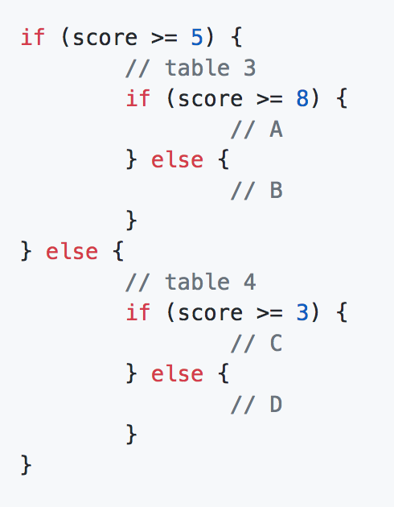
Problem 8.3
Notes:
This is just one possible answer that you can get from following the tables directly.

Slide 28
Problem 9.1
Fill in the table below.
a | b | a && b | a || b | !a
true | true
true | false
false | true
false | false
Notes:
Can someone fill in the table here?

Slide 29
Problem 9.1
Fill in the table below.
a | b | a && b | a || b | !a
true | true | true | true | false
true | false | false | true | false
false | true | false | true | true
false | false | false | false | true
Notes:
Can someone fill in the table here?

Slide 30
Problem 9.2
This function returns the maximum value given three numbers:
long max_of_three(long a, long b, long c) { long max = 0; if ((a > b) && (a > c)) { // a is larger than b and c max = a; } if ((b > a) && (b > c)) { // b is larger than a and c max = b; } if ((c > a) && (c > b)) { // c is larger than a and b max = c; } return max; }
Notes:
(20 mins)

Slide 31
Problem 9.2 (a)
What is wrong with this code?
long max_of_three(long a, long b, long c) { long max = 0; if ((a > b) && (a > c)) { // a is larger than b and c max = a; } if ((b > a) && (b > c)) { // b is larger than a and c max = b; } if ((c > a) && (c > b)) { // c is larger than a and b max = c; } return max; }
Notes:
(20 mins)
The problem is that we did not check for equality here! What will happen if a == b or a == c or b == c?

Slide 32
Problem 9.2 (b)
Give a sample test value of a, b, c that would expose the bug.
long max_of_three(long a, long b, long c) { long max = 0; if ((a > b) && (a > c)) { // a is larger than b and c max = a; } if ((b > a) && (b > c)) { // b is larger than a and c max = b; } if ((c > a) && (c > b)) { // c is larger than a and b max = c; } return max; }
Notes:
An obvious answer is where a, b, and c are equal. In this case, max would be 0.

Slide 33
Problem 9.2 (b)
What are other possible values of a, b, and c?
1. a == b == c
2. a == b or a == c or b == c
Notes:
An obvious answer is where a, b, and c are equal. In this case, max would be 0.

Slide 34
Problem 9.2 (b)
1. a == b == c
2. a == b or a == c or b == c
Q: What if there is a tie among two numbers to be max? Will this work?
e.g. (2, 2, 1)
A: No! max will still be 0.
Notes:
Now, if a, b, c are all different, then the code works as intended. There are two cases remaining:
what if there is a tie among two numbers to be the max? (e.g., 2 2 1). This does not work either, and max would be 0.
what if the two numbers that is not the max are equal? (e.g., 2 1 1). This works.

Slide 35
Problem 9.2 (b)
1. a == b == c
2. a == b or a == c or b == c
Q: What if there is a tie among two numbers that are not max? Will this work?
e.g. (2, 1, 1)
A: Yes, it will.
Notes:
Now, if a, b, c are all different, then the code works as intended. There are two cases remaining:
what if there is a tie among two numbers to be the max? (e.g., 2 2 1). This does not work either, and max would be 0.
what if the two numbers that is not the max are equal? (e.g., 2 1 1). This works.

Slide 36
Problem 9.2 (c)
Fix the code to remove the bug.
long max_of_three(long a, long b, long c) { long max = 0; if ((a > b) && (a > c)) { // a is larger than b and c max = a; } if ((b > a) && (b > c)) { // b is larger than a and c max = b; } if ((c > a) && (c > b)) { // c is larger than a and b max = c; } return max; }
Notes:
How can we fix the code? (To fix the code, we just need to check for equality.)

Slide 37
Problem 9.2 (c)
Fix the code to remove the bug.
long max_of_three(long a, long b, long c) { long max = 0; if ((a >= b) && (a >= c)) { // a is larger than b and c max = a; } if ((b >= a) && (b >= c)) { // b is larger than a and c max = b; } if ((c >= a) && (c >= b)) { // c is larger than a and b max = c; } return max; }
Notes:
To fix the code, we just need to check for equality.
Note that we check for equality for all three to maintain symmetry of the code.

Slide 38
Problem 9.2 (d)
Before we replace the if-statements with if-else statements, let’s try to draw a flowchart first.
a >= b?
input
a, b, c
NO
YES
a >= c?
NO
?
YES
max = a
Notes:
What do you think can replace this question mark?
(can be b >= a, but better still, directly max = c!!)

Slide 39
Problem 9.2 (d)
Before we replace the if-statements with if-else statements, let’s try to draw a flowchart first.
a >= b?
input
a, b, c
NO
YES
a >= c?
NO
max = c
YES
max = a

Slide 40
Problem 9.2 (d)
Before we replace the if-statements with if-else statements, let’s try to draw a flowchart first.
a >= b?
?
input
a, b, c
NO
YES
a >= c?
NO
max = c
YES
max = a

Slide 41
Problem 9.2 (d)
Before we replace the if-statements with if-else statements, let’s try to draw a flowchart first.
a >= b?
is b >= c?
input
a, b, c
max = b
NO
YES
YES
NO
a >= c?
NO
max = c
YES
max = a

Slide 42
Problem 9.2 (d)
Replace the if-statements with if-else statements.
a >= b?
is b >= c?
input
a, b, c
max = b
NO
YES
YES
NO
a >= c?
NO
max = c
YES
max = a
Notes:
Can someone now try to write the corresponding if-else statements?

Slide 43
Problem 9.2 (d)
Replace the if-statements with if-else statements.
long max_of_three(long a, long b, long c) { long max = 0; if (a >= b) { if (a >= c) { max = a; } else { max = c; } else if (b >= c) { max = b; } else { max = c; }
return max; }
Notes:
Draw the corresponding flowchart as well!

Slide 44
Problem 9.3
Write a function that takes in a blood pressure measurement, and prints either low, ideal, pre-high, and high depending on the input values.
Notes:
(10 mins)
By this time, 65 minutes.

Slide 45
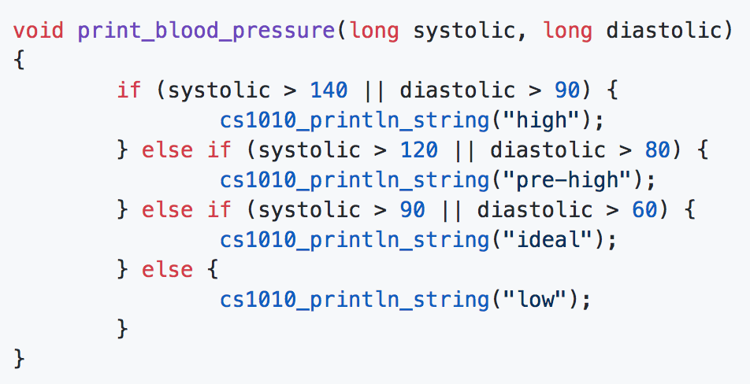
Problem 9.3
Approach 1: Using || from the high region

Slide 46
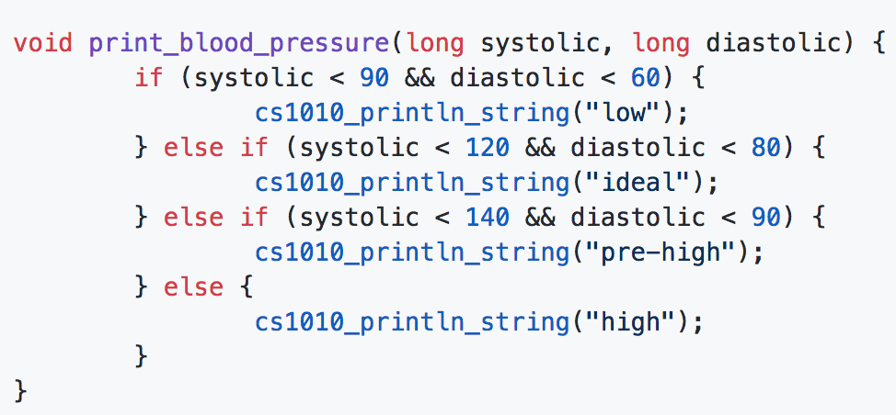
Problem 9.3
Approach 2: Using && from the low region

Slide 47
Before Ex1…
Crash course on numbers and types
In computers, numbers are represented as bits of 0s and 1s (binary).
e.g. 16 = 10000
Notes:
Ok last week we looked briefly at types. I went back to think about it, and I think some of you may still be quite confused.
So now, let’s go on a 2 minutes crash course on numbers and types.
In computers, numbers are represented in bits of 0 or 1. This is called binary.
For example, 16 can be represented as 10000.

Slide 48
Before Ex1…
Crash course on numbers and types
To represent bigger numbers, more bits are needed.
e.g. 16 = 10000
512 = 1000000000
Notes:
Then, to represent bigger numbers, more bits are needed. So here, 512 needs 10 bits to be represented, while 16 only needs 5 bits.

Slide 49
Before Ex1…
Crash course on numbers and types
In C, there are different types (ways to represent numbers).
int: at least 16 bits (usually 32 bits)
long: at least 32 bits
double: 64 bits
Notes:
The exact number of bits depends on the implementation and the compilation.

Slide 50
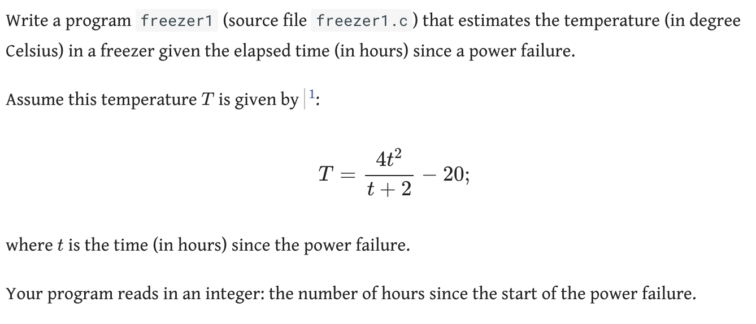
Review: Exercise 1 (a)
Notes:
(5 mins)

Slide 51
Review: Exercise 1 (a)
Step 1. Read in an integer
How to read in the integer?
Notes:
To read, you can use a method from the cs1010 library → cs1010_read_long or read_double

Slide 52
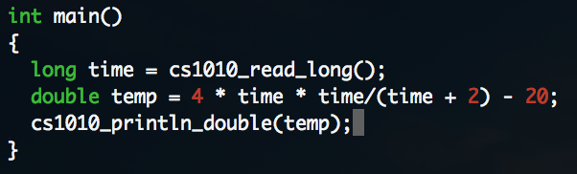
Review: Exercise 1 (a)
Step 2. Compute the temperature
Is this correct?
Notes:
Is this correct??

Slide 53
Review: Exercise 1 (a)
Step 2. Compute the temperature
Integer division!!
Notes:
No!

Slide 54
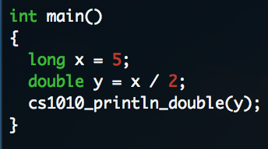
Review: Exercise 1 (a)
Step 2. Compute the temperature
Notes:
In this example, what is the output?
It is not 2.5, but 2! This is because C will treat x like an integer, and the 2 like an integer, so when division occurs, the resulting value is also an integer!

Slide 55
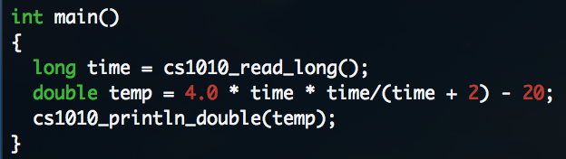
Review: Exercise 1 (a)
Step 2. Compute the temperature
Notes:
This is a solution to exercise 1 (a). Those who still don’t understand why they are wrong, please ask again on the telegram group.

Slide 56
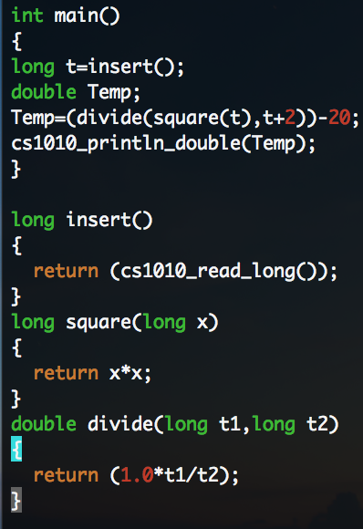
Review: Exercise 1 (a)
Spot the problem
Notes:
What is wrong with this program? Why does it not work?

Slide 57
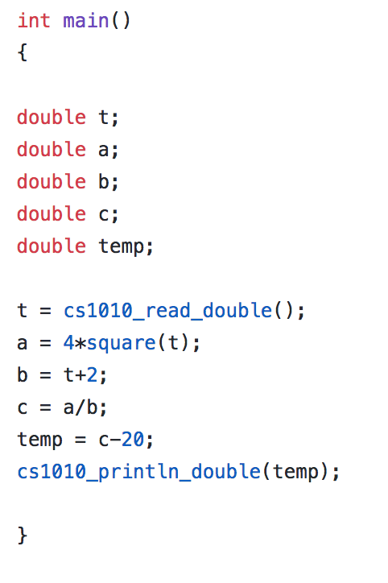
Review: Exercise 1 (a)
Spot the style problem(s)

Slide 58
Review: Exercise 1 (a)
Spot the style problem(s)
Give variables descriptive names!
Inconsistent indentation!

Slide 59
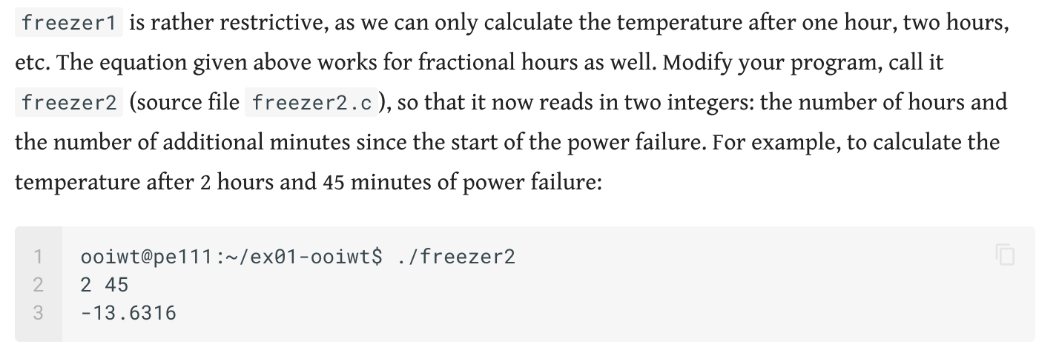
Review: Exercise 1 (b)
Notes:
This is similar to part(a), but with an additional calculation.
If you are not sure, you can ask in the group/ ask me again.

Slide 60
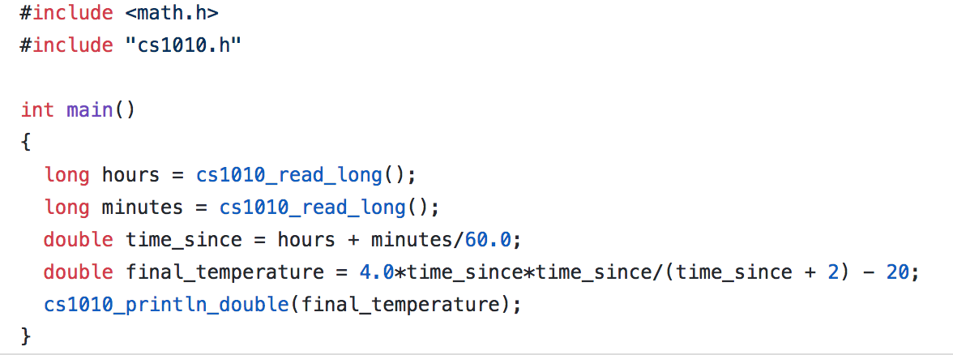
Review: Exercise 1 (b)
Notes:
Here is an example solution for the problem.

Slide 61
Exercise 2
Notes:
(25 mins)

Slide 62
End.

Slide 63
Reference Slides

Slide 64
Problem 8.1
long factorial(long n) { if (n == 0) { return 1; } return n * factorial(n - 1); }
long factorial(long n) { if (n == 0) { return 1; } else { return n * factorial(n - 1); } }

Slide 65
Problem 8.1
long factorial(long n) { long results; if (n == 0) { results = 1; } results = n * factorial(n - 1); return results; }
long factorial(long n) { long results; if (n == 0) { results = 1; } else { results = n * factorial(n - 1); } return results; }

Slide 66
Problem 8.2
if (x > y) { max = x; } if (x < y) { max = y; } if (x == y) { max = y; }
if (x > y) { max = x; } else { max = y; }

Slide 67
Problem 8.2
x > y
x < y
x == y
input
x, y
output max
NO
NO
YES
YES
YES
max = x
max = y
max = y

Slide 68
Problem 8.2
x > y
max = y
input
x, y
output max
NO
YES
max = x

Slide 69
Problem 8.3
Table 3 (5 or higher)
Score | Letter Grade
5 or higher | See Table 3
Less than 5 | See Table 4
Score | Letter Grade
8 or higher | A
Less than 8 | B
Table 4 (less than 5)
Score | Letter Grade
3 or higher | C
Less than 3 | D

Slide 70
Problem 9.1
a | b | a && b | a || b | !a
true | true
true | false
false | true
false | false

Slide 71
Problem 9.2
long max_of_three(long a, long b, long c) { long max = 0; if ((a > b) && (a > c)) { // a is larger than b and c max = a; } if ((b > a) && (b > c)) { // b is larger than a and c max = b; } if ((c > a) && (c > b)) { // c is larger than a and b max = c; } return max; }

Slide 72
Problem 9.2
a >= b?
input
a, b, c
NO
YES
a >= c?
NO
max = c
YES
max = a

Slide 73
a >= b?
is b >= c?
input
a, b, c
max = b
NO
YES
YES
NO
a >= c?
NO
max = c
YES
max = a

Slide 74
Problem 9.3

